Slide 1
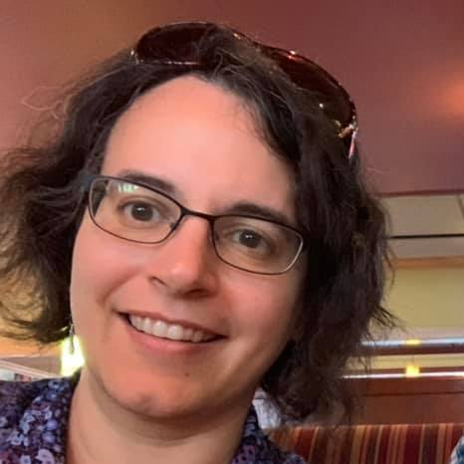



UPLOAD YOUR PHOTO HERE
How to grow data forests with XML trees
Elisa Beshero-Bondar, PhD
Director, Center for the Digital Text
Associate Professor of English
U. of Pittsburgh, Greensburg
@epyllia
YOUR INSTITUTION HERE
Notes:
Hi! I’m Elisa Beshero-Bondar from Pitt-Greensburg’s Center for the Digital Text! I’m here to show you, rapidly, the kinds of projects you can build starting with eXensible Markup Language (XML), and How to grow data forests with XML trees.

Slide 2
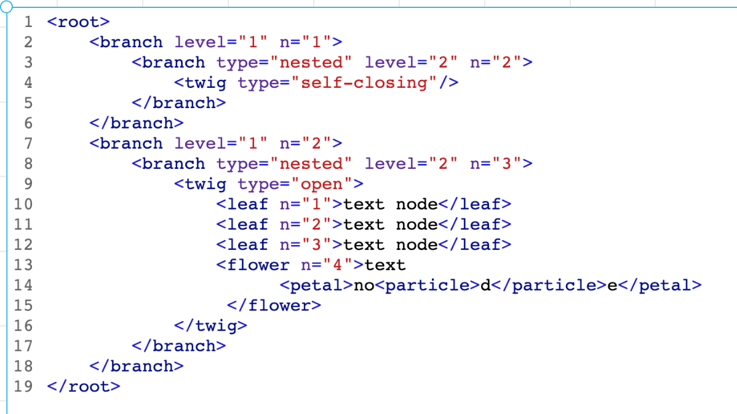
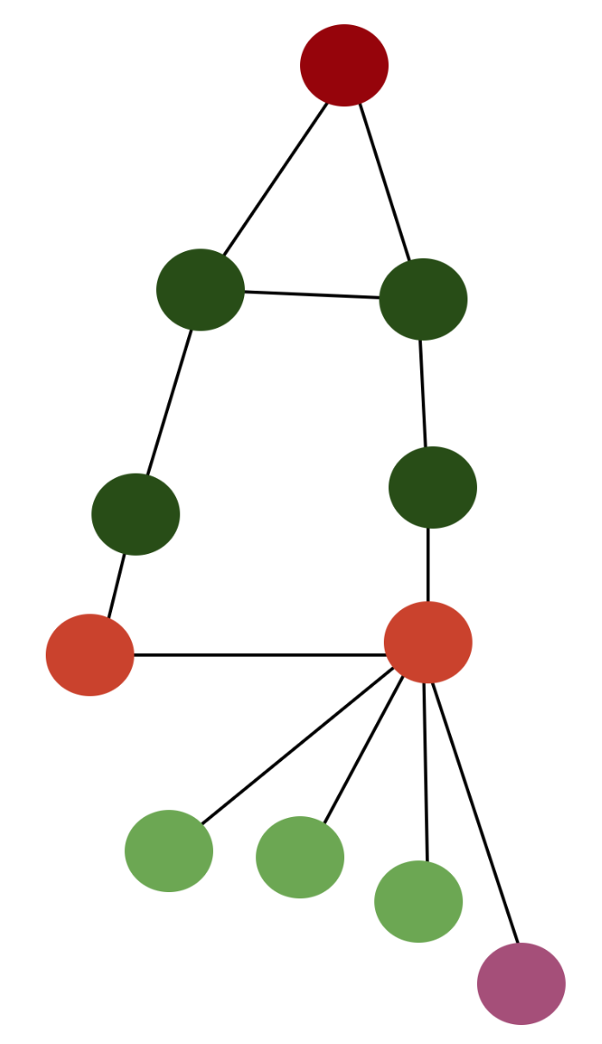
XML is a tree
Notes:
XML follows a tree data structure: that is, it makes a hierarchy from a single root element, and from that root (like the root of a tree) we make as many branches and nested leaves as we wish. In a way, it might help to think of this as something you can see SIDEWAYS in an XML document, with the root node embracing the whole. If we put a collection of XML documents together, we begin to make a forest, and they don’t all have to be structured the same way.

Slide 3
Your text is not a tree, but markup data grows on trees… I avail myself of the return of our friend Mr. Talfourd to send you another Article for the Magazine[2] --I have one ^^{half written}, which you shall have by the middle of next week at latest--much sooner if I can find an opportunity--[Gap: 1 chars, reason: torn.][o]n the subject of the "Mayings" which the Country people hold in the North of Hampshire--I mention this to you because perhaps on account of the subject you might like to keep room for it this Month--It will be rather longer than the enclosed but not much.
Notes:
It’s important to realize that a tree data structure doesn’t really represent a text (or document or work) in real life. It’s something we impose in order to collect and organize data we care about. What you see on the screen here is built from XML markup data, and it’s representing a passage from a torn manuscript of a letter from 19th-c. author Mary Russell Mitford to Samuel Hamilton. Markup data helps us to capture lots of information in this passage about people, publications, the condition of the manuscript (where the hole is) and places.

Slide 4
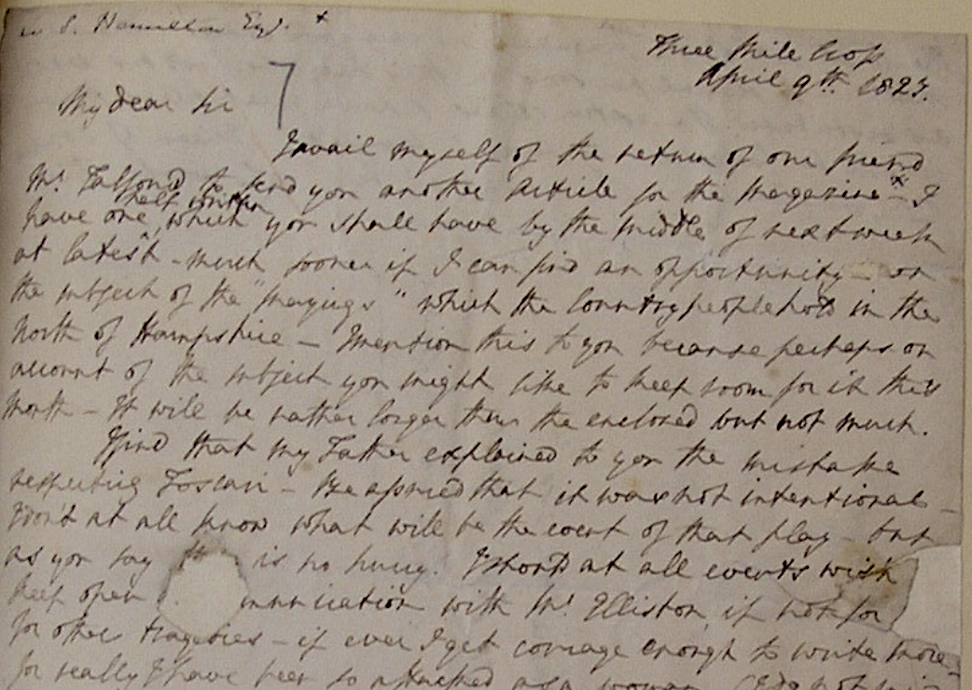
Notes:
Here’s a look at a photofacsimile of that passage, the opening of a letter. The handwriting itself contains some markup (see the insertions, the labeling at the top left n another hand for example. In figuring out how to encode a primary source like a manuscript, we want to decide our organizing principle for an XML hierarchy: do we organize page by page or paragraph by paragraph (understanding that these will span pages)? We can downplay the page organization by using self-closing elements—milestone markers for a page--nested inside the paragraphs, and that’s the strategy we use in the Mitford project, where we want to study relationships established among people, places, and publications inside a holding paragraph.

Slide 5
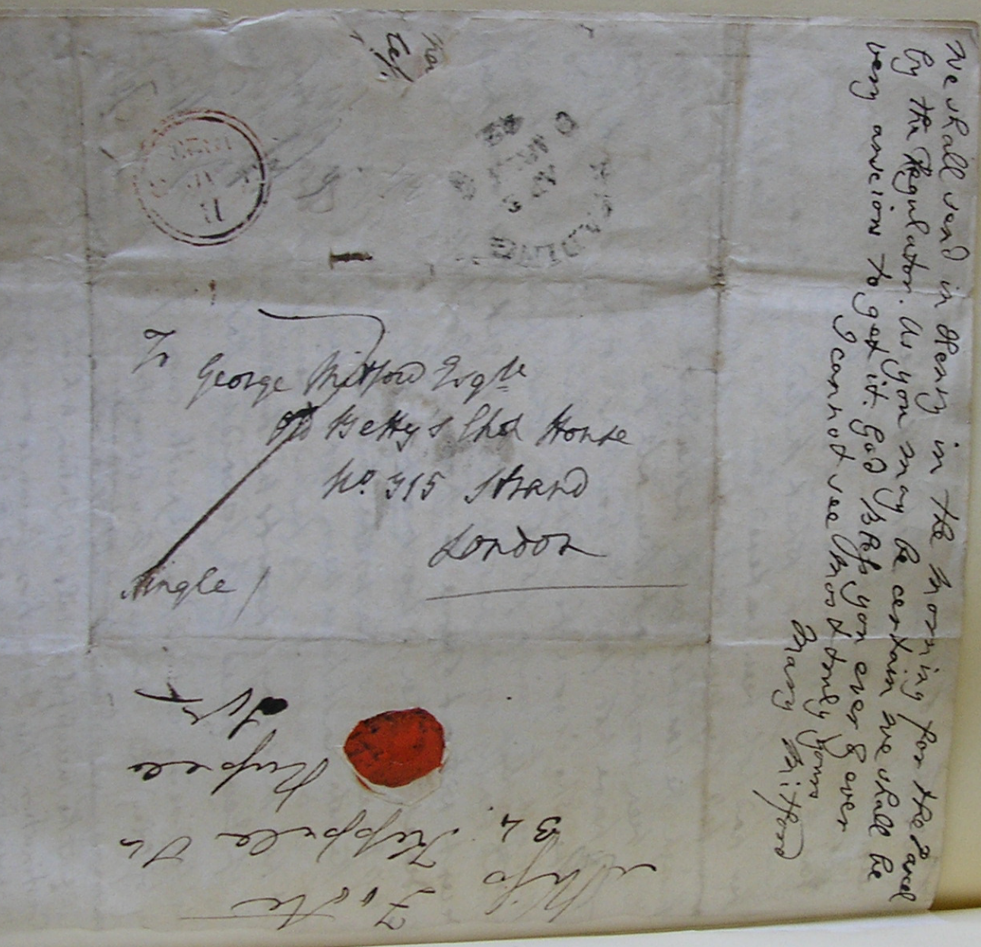
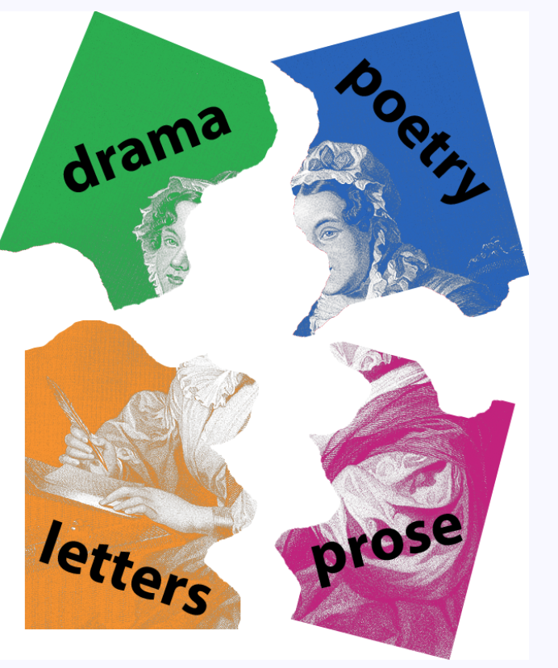
Digital Mitford project: https://digitalmitford.org
Notes:
Here we see the complexity of surfaces and hands that we try to capture with markup—on the right is handwriting of Mitford’s mother, folded into the address leaf. We see wax seals and postmarks—and we can decide whether or not to encode these in detail based on position on paper, or whether simply to describe them as METADATA, information preserved in a heading. We choose the latter and follow the Text Encoding Initiative, or TEI encoding Guidelines for describing this information—TEI gives us choices about this that we need to decide on as well as a controlled vocabulary for organizing our XML data model. Really it offers a wonderful textbook for electronic encoding of primary sources—for anything we can call writing on a surface (from inscriptions on tablets to manuscripts and printed documents)

Slide 6
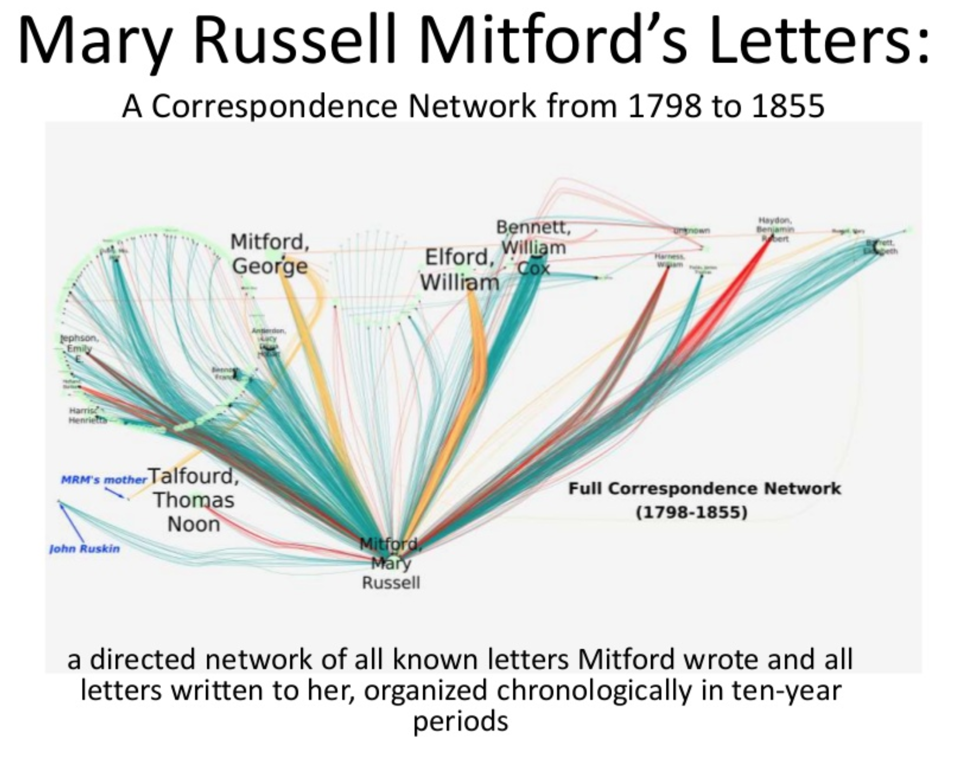
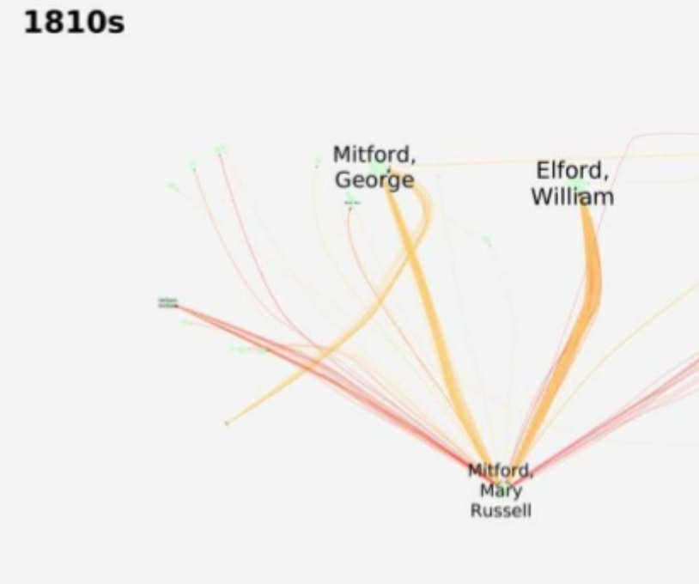
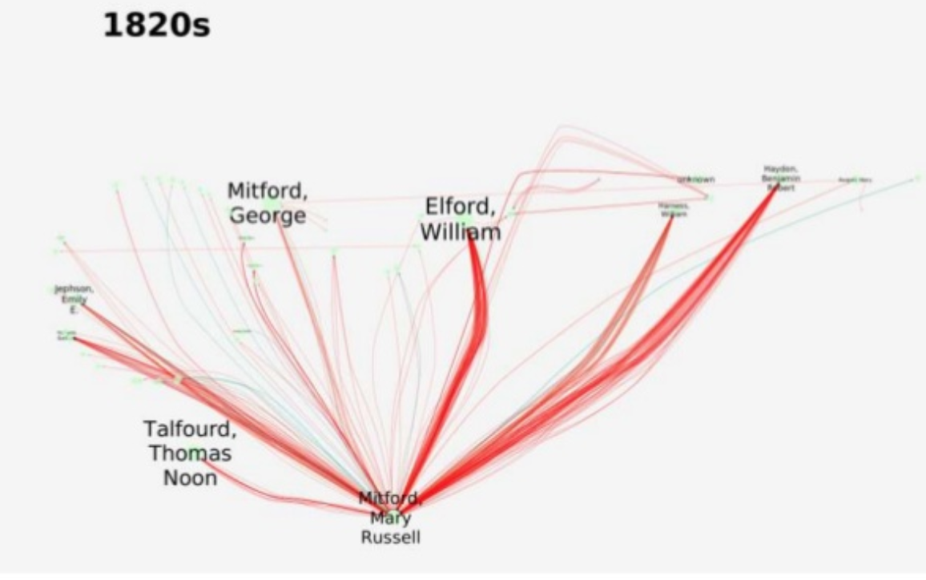
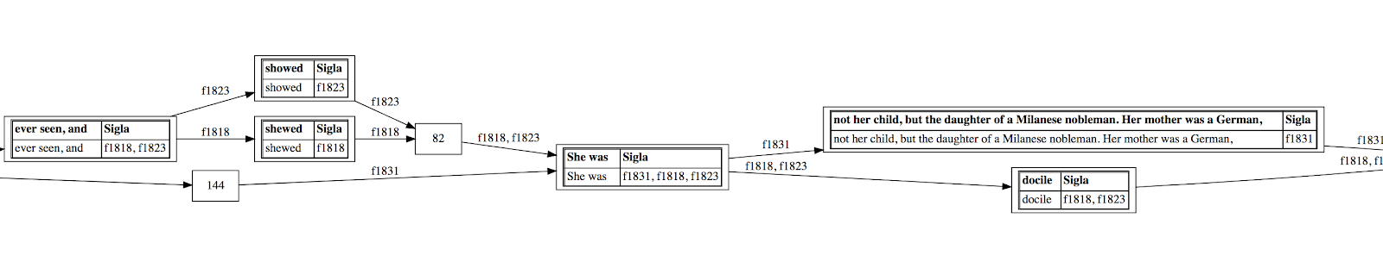
Pull data from XML trees, weave it into network graphs
Notes:
We are not stuck inside our hierarchical XML data structure—and we can choose to encode in order to PULL or extract data from the trees, and express its relationships in alternative ways for visualization. Here are examples from two of my projects. In the Mitford project, we pulled data about the people to whom Mitford was writing over thousands of latters, and visualized this in a series of network graphs by decade. We also can visualize how different versions of the same document cluster and diverge in relation to another—as seen in this data from the Frankenstein Variorum project.

Slide 7
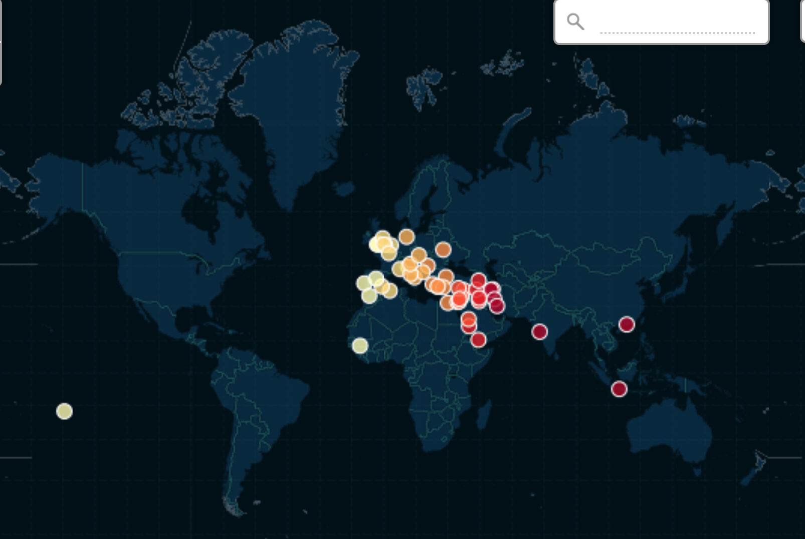
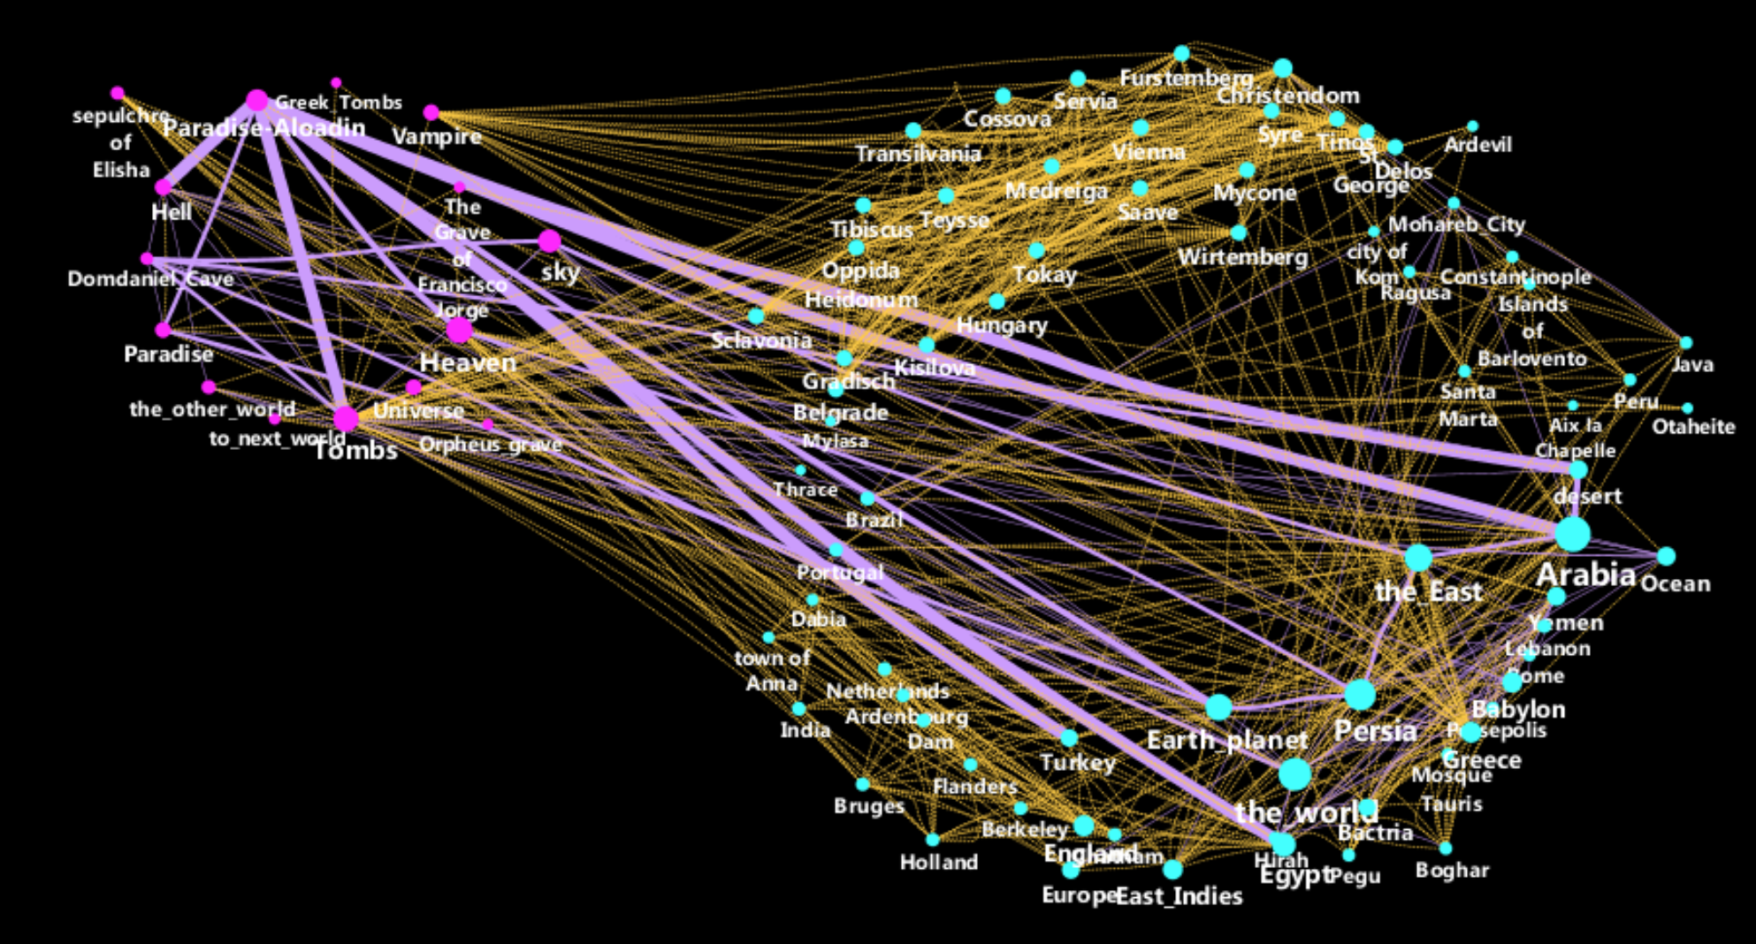
Data pulled from XML markup of Robert Southey’s annotated epic poem, Thalaba the Destroyer (1801)
Mappable and mythical places (node colors)
Location in main text or footnotes (edge colors)
If in main text: weighted if the character visits the place, unweighted if analogy or allusion to a place
Project site: Juxtapositions of place in Robert Southey’s Thalaba the Destroyer

Slide 8
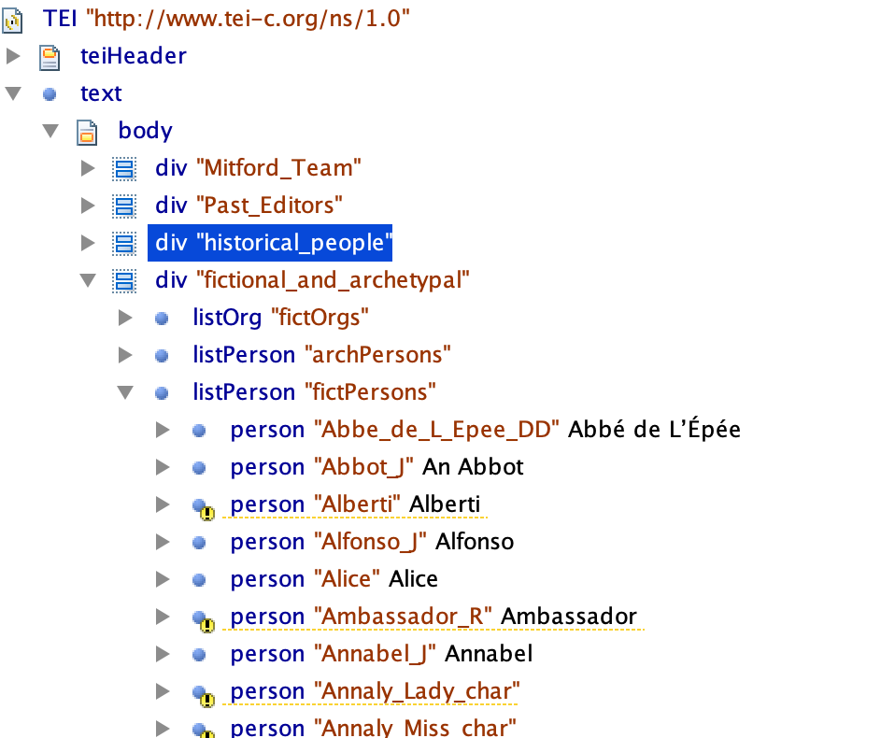
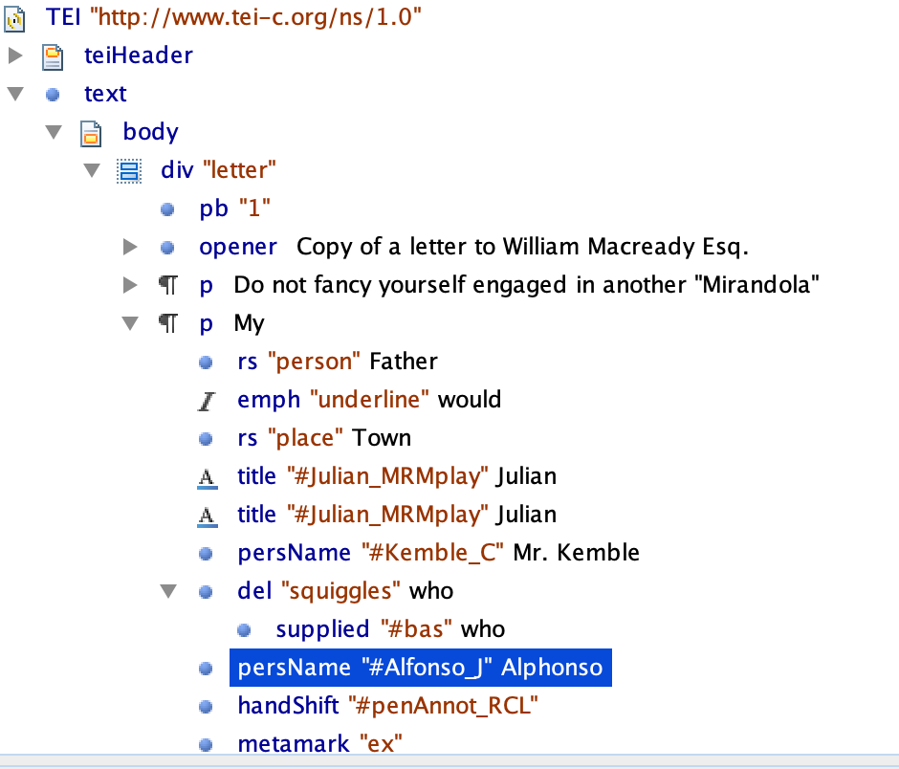
XML trees interweave with other trees: a forest data ecosystem
Notes:
In a real project, we construct XML trees of multiple kinds and interweave them together. Here on the left is a view of the structure of our Site Index for the Digital Mitford project, with details on named persons, places, organizations, etc. On the right is a document hierarchy for a letter, which references data on the Site Index tree to dereference people, places, organizations, etc. Our trees are interwoven in controlled ways with rules called schemas that we also express with XML .

Slide 9
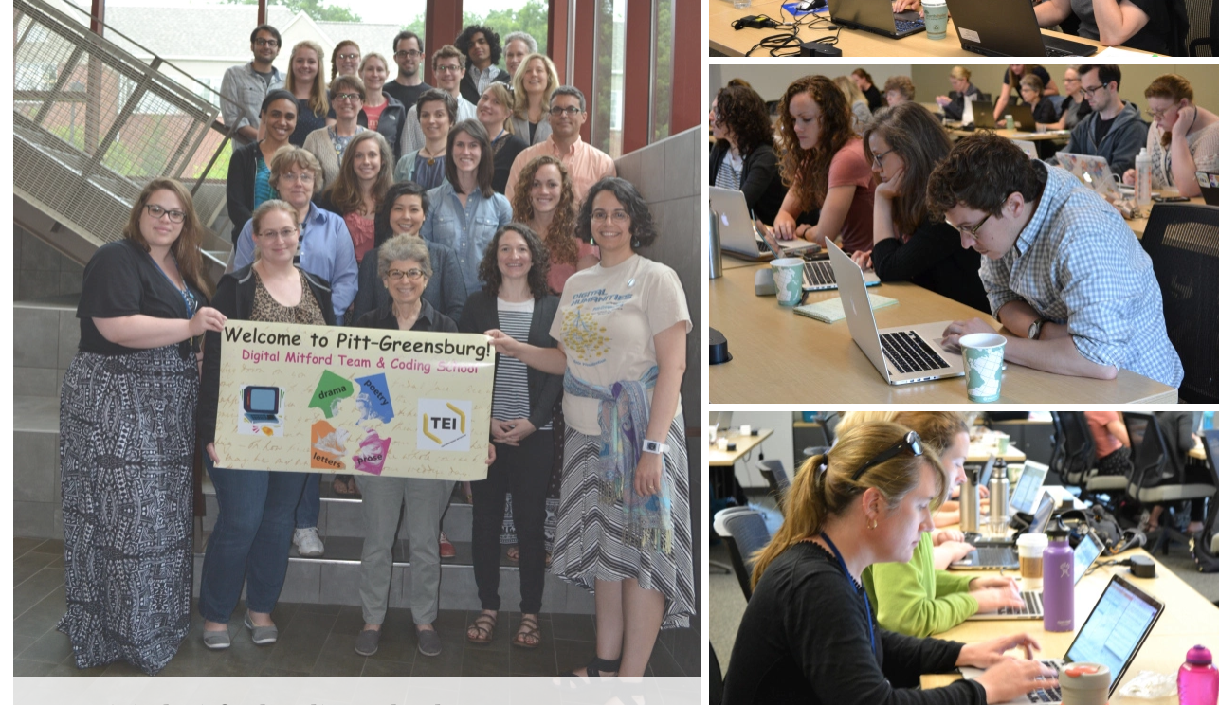
XML and TEI grow community data forests with trees
Notes:
XML projects can bring people together when XML is written with a shared controlled vocabulary. Every year at Pitt-Greensburg campus we bring together people interested in learning from the Digital Mitford project how to build an XML forest ecosystem and how to work in structured ways with XML data. This is something to share with students and colleagues across institutions—and the forests we build become resources for long-range ongoing research of many kinds. XML data can build research hives, as it has done with our Mitford project.

Slide 10
Into the forest! For more information and guidance…
Text Encoding Initiative (TEI) P5 Guidelines for Electronic Text Encoding and Interchange: https://www.tei-c.org/release/doc/tei-p5-doc/en/html/index.html
Course materials on the XML family of languages at https://dh.newtfire.org and http://dh.obdurodon.org
An introduction to network analysis and cytoscape for XML coders: http://ebeshero.github.io/thalaba/cytosc.html
Digital Mitford project: https://digitalmitford.org, Coding School site: https://digitalmitford.github.io/DigMitCS/
Newtfire (a forest ecosystem of projects): https://newtfire.org
Frankenstein Variorum on GitHub: https://pghfrankenstein.github.io/Pittsburgh_Frankenstein/
Juxtapositions of place in Robert Southey’s Thalaba the Destroyer: http://ebeshero.github.io/thalaba/index.html
XPath for processing XML and managing projects (DHSI course materials 2019): https://ebeshero.github.io/UpTransformation/ (2020 title will be Code the X-files using the XML family of languages)
Notes:
Learning XML is not difficult—learning to transform and pull data from it and build visualizations is a matter of weeks and months, not years. Here are some resources for learning more, including some annual workshops we hold and teaching materials you can follow on your own, and resources to help you see the forest from the trees!

